Slide 1
Climate Change Elements of the SADC Regional Agricultural Policy (RAP)
CCARDESA Secretariat,
Gaborone, Botswana
Notes:
Prepared by B. Podisi, CCARDESA; with modifications by Wiebke Foerch, GIZ

Slide 2
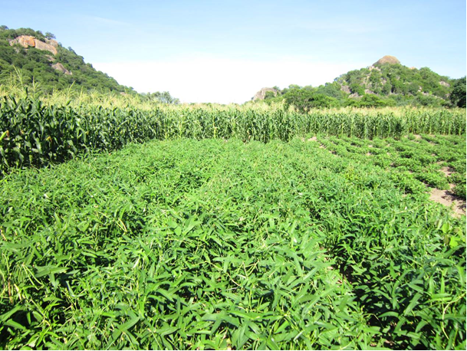
Introduction
Agriculture is central to poverty reduction in SADC and thus a priority sector
Agriculture provides a livelihood for 61% of the SADC population and contributes 17% to the regional GDP
Dar es Salaam Declaration 2004

Slide 3
Regional Agricultural Policy - RAP
Purpose:
To define common agreed objectives and measures to guide, promote and support actions at regional and national levels in the agricultural sector of the SADC Member States in contribution to regional integration and the attainment of the SADC Common Agenda
RAP is a legally binding instrument linked to planning and budgeting in the Member States

Slide 4
Goal and Objectives of the RAP
Goal: to contribute towards the attainment of the SADC Common Agenda which promotes sustainable and equitable economic growth and socio-economic development
Overall objective: to contribute to sustainable agricultural growth and socio-economic development
Specific objectives:
Enhance sustainable agricultural production, productivity and competitiveness;
Improve regional and international trade and access to markets of agricultural products;
Improve private and public sector engagement and investment in the agricultural value-chains;
Reduce social and economic vulnerability of the region’s population in the context of food and nutrition security and the changing economic and climatic environment.

Slide 5
Climate Change Elements of the RAP
Climate change is covered under objective (iv) - Reduce social and economic vulnerability
Policy Statement: SADC shall support measures to improve the region’s capacity to adapt to and mitigate climate change and variability
The RAP recognizes effects of droughts, floods and temperature change on the agriculture sector
Key issues addressed in the RAP:
How to adapt to and mitigate climate change and variability
How to foster a unified regional response to climate change

Slide 6
Climate Change Interventions in the RAP
Strengthening regional research in developing appropriate adaptation strategies for climate variability and change in the agriculture sector;
Developing capacity for carbon stock inventory and analysis with a view to enabling the agriculture sector to benefit from carbon trading;
Promoting R&D on climate change and variability data and information generation and dissemination for the provision of early warning information to farmers;
Promoting adoption and incorporation of sound environmental impact mitigation measures in national and regional agricultural policies and programmes;
Ensuring the effective engagement and participation of the agriculture sector in theinternational dialogue on climate change; and
Supporting SADC Member States to achieve their own climate change policies, strategies and programmes

Slide 7
RAP Domestication in Member States
The Climate Change component will be implemented through the Food and Nutrition Security Strategy 2015-2025
Facilitating capacity building on adaptation and mitigation
Promoting dissemination of information and sharing of best practices on adaptation and mitigation
Climate Change Strategy
Promote water supply, conservation and related infrastructure development
Promote the use of adaptive agricultural technologies and techniques and provide incentives for the development of green agri-business
Develop a regional framework for agriculture research and development
Reduce agricultural (crop and livestock subsectors) vulnerability to climate change and variability, incorporating adaptation measures in relevant regional policies
Promote interventions that improve resilience among vulnerable communities

Slide 8
CAADP - Pillar 4 Institution: CCARDESA
Pillar 1: Extending area under sustainable land management
Pillar 2: Rural infrastructure, trade related capacities & market access
Pillar 3: Improving food supply and reducing hunger
Pillar 4: Agricultural research - technology development, dissemination and adoption
Sub regional organisations to lead attainment of Pillar 4

Slide 9
Roles of CCARDESA
To coordinate implementation of regional R&D programmes
Facilitate collaboration among NARs & CGIAR
Promote public-private partnerships in regional agricultural R&D
Improve agricultural technology generation, dissemination, and adoption in the region through collective efforts, training and capacity building

Slide 10
Roles of CCARDESA cont’d
To empower and strengthen farmers and their organisations or groups into effective partners in agricultural development and enhancing their access to markets and negotiating skills
To facilitate development of sustainable education, training and learning systems that contribute to farmer-oriented innovation and technology transfer systems for the region
To promote co-operation, consultation and exchange of scientific and technical information on best practices in agric. research and advisory services in the SADC region.

Slide 11
CCARDESA: Mission and Themes
VISION: A food secure and prosperous Southern African region with vibrant rural livelihoods
MISSION: To promote innovative research, technology generation
and adoption for sustainable agricultural development
through effective partnership and capacity building
Farmer Empowerment & Market Access
Research and Technology generation and farmer demand driven advisory services
Knowledge, Information and Communication
Institutional Development and Capacity Building
Establishment and Strengthening of CCARDESA as an effective SRO
THEME 1
THEME 2
THEME 3
THEME 4
THEME 5

Slide 12
CCARDESA and Climate change
ACCRA supports
CCARDESA as knowledge broker on agriculture
Climate proofing of agricultural value chains
Knowledge dissemination of climate smart agriculture
Recent ACCRA EVENTS
Training for Extension Workers (Swaziland)
CSA Conference (South Africa)

Slide 13
THANK YOU

